Slide 1

KneeVision
Team S.T.A.R Labs

Slide 2

Agenda
01
02
03
04
05
PROJECT OVERVIEW
PROJECT BACKLOG
TEAM METRICS
PRODUCT
SPRINT 0 RECAP
Research Team
Improvements
Project Description
Team Working Agreement
Personas
MVP
Languages and Tools
Algorithms
Diagrams
User Stories
Sprint 1 Stories
Test Cases
Team Velocity
Burndown Charts
Completed/Committed Ratio
Sprint 1 Retrospective
Sprint 2 Planning
API
Live Application Demo

Slide 3
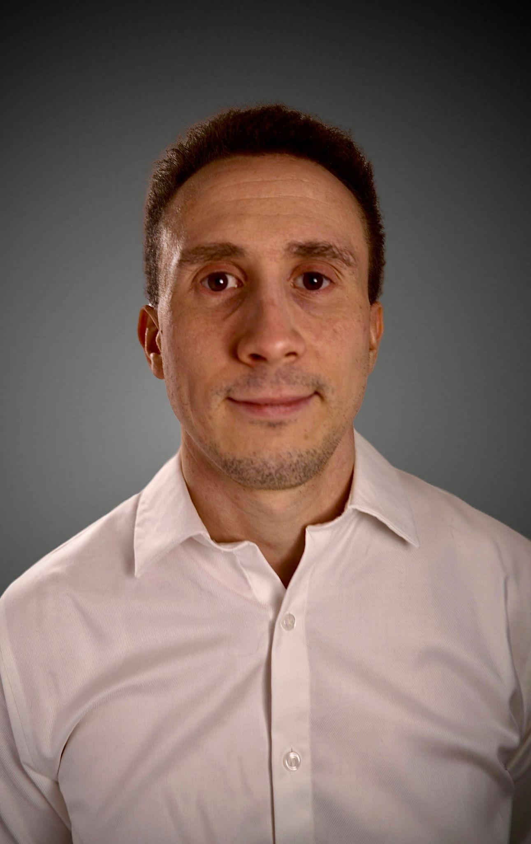

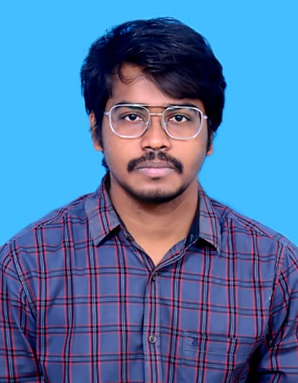
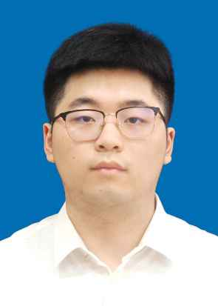
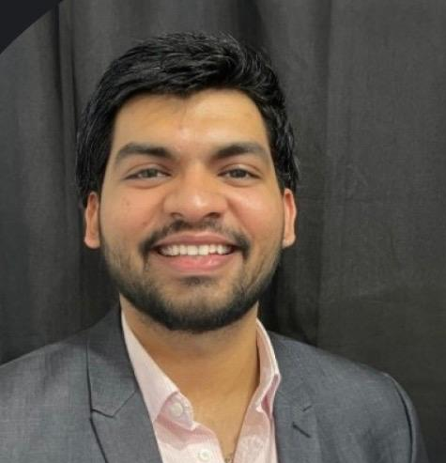

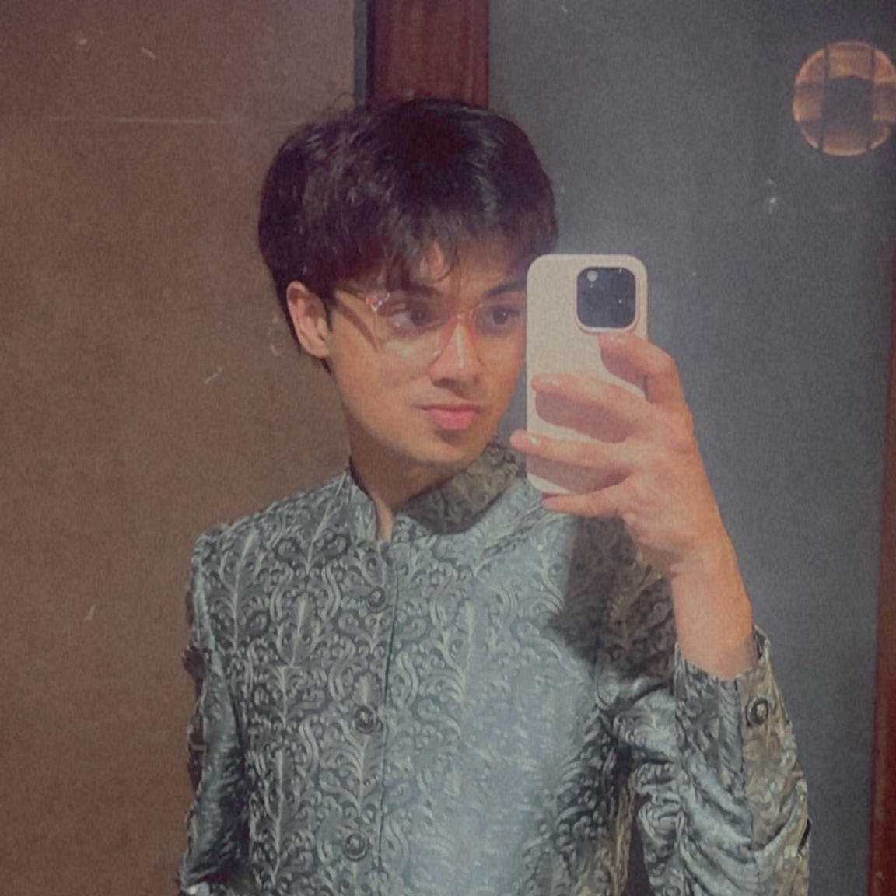
Our Research Team
Daniel Fox
Team Leader/
Developer
Manohar Killamsetti
Scrum Master/Developer
Siming Li
Developer/Tester
Sarvesh Shah
Cloud Developer
Swatej Goud
Backend Developer
Deep Patel
ML Developer

Slide 4
Improvements
Project Description Page added (slide 7)
Updated Tools & Technologies slide to include revised choices (slide 15)
Added Technologies and Algorithms explanations (slides 16 - 20)

Slide 5
Problem Statement
Knee X-ray imaging is commonly used to evaluate osteoarthritis, yet interpreting radiographic signs of disease severity can be subjective and inconsistent due to subtle visual differences and reliance on manual assessment. While advanced imaging techniques such as MRI provide greater detail, they are expensive and less accessible. This creates a need for scalable and consistent analysis methods that can assist in assessing knee osteoarthritis using widely available X-ray images.

Slide 6
Project Definition
A web-based platform that uses deep learning to analyze knee X-ray images for knee osteoarthritis severity assessment.
Intended for individuals, researchers, and clinicians seeking consistent and scalable analysis of knee X-ray data.
Leverages publicly available datasets and established convolutional neural network (CNN) models.
Designed as an AI-assisted decision-support and research tool, not a diagnostic system.
Benefits include improved consistency, scalability, and reduced subjectivity in manual X-ray interpretation.

Slide 7
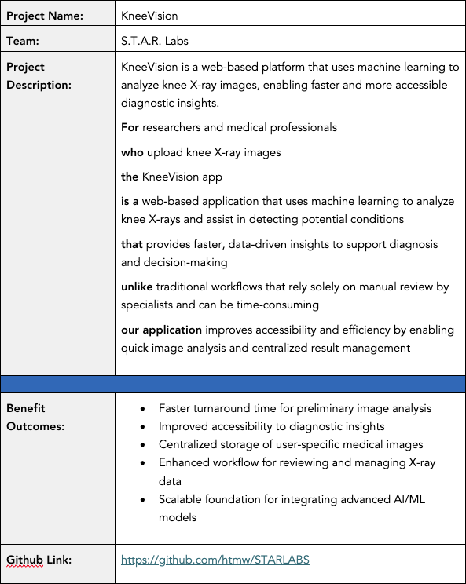
Project Description

Slide 8
Team Agreement: Collaboration Standards
Meeting Pattern
Synchronous sessions twice weekly (Sun/Tue). Mandated Agenda
documents for every session.
Continuous async sync via WhatsApp/Discord.
Decision Making
Majority-vote consensus based on researched evidence. Inclusive voicing of concerns during all discussion phases.
Technical Workflow
No direct pushes to Main. Isolated feature branches only.
Peer Approval. Every PR requires at least one secondary reviewer.
Jira Hygiene. Mandatory linking of work to Jira tracker IDs.
Blockers. Resolve locally & document attempts before escalation.

Slide 9
Team Agreement: Definition of “Done”
Category | Standard for Completion
Execution | Code runs without syntactical or runtime errors.
Compliance | Work meets all Industry Standards.
Verification | Work reviewed by multiple members & verified on multiple systems.
Documentation | All necessary docs tagged or updated along with code push.
Testing | All pre-defined test scenarios must be passed.

Slide 10


Persona - 1: The Practitioner
ORTHOPEDIC SURGEON | URBAN TEACHING HOSPITAL
Dr. Sarah Chen, 42
An expert in orthopedic medicine with 15 years of experience. Sarah operates in high-volume clinics where diagnostic speed is paramount to patient throughput and surgical triage.
KEY GOALS
Rapid knee X-ray triage
Fatigue from patient volume
Reduce initial assessment time
Reader reporting variability
Limited case analysis time
Validation for borderline cases

Slide 11

Persona - 2: The Research Coordinator
CLINICAL RESEARCH COORDINATOR
Alex Rodriguez, 29
A data-centric professional managing multi-site studies. Alex focuses on standardization, data integrity, and inter-rater reliability across large datasets.
STRATEGIC GOALS
•
Standardize severity grading
Efficient batch processing
•
•
Structured data exporting
Ensure rater reliability
OPERATIONAL PAINS
Manual grading inconsistency
Lengthy training cycles
•
•
Audit trail requirements
•
•
Historical data re-analysis

Slide 12

Persona - 3: The Learner
3RD YEAR MEDICAL STUDENT
Maya Patel, 24
A digital native in her clinical rotations. Maya uses the platform as a pedagogical tool to build pattern recognition skills and diagnostic confidence before her residency.
LEARNING GOALS
ACCESS OBSTACLES
•
Identify radiographic signs
•
Limited diverse case access
•
Immediate feedback practice
•
Assessment uncertainty
•
Grade/Clinical correlation
•
Limited attending time

Slide 13
What will our MVP be?
Web-based interface
Image preprocessing pipeline
Deep learning model
Severity assessment output
Basic result visualization
Mobile-responsive UI

Slide 14
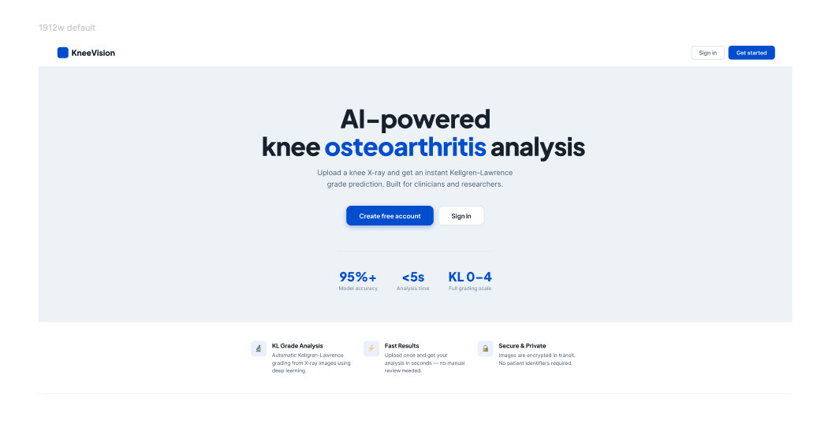
Project Design (Figma)

Slide 15

















Tools & Technologies
Languages:
Frontend:
Backend:
ML/DL Libraries:
Database:
Cloud:
Tools:
ML Inference:
Misc. Libraries:

Slide 16




FRONTEND
React · Vite · Tailwind CSS · TypeScript
React 18
Vite
Tailwind CSS
TypeScript
Component-based UI
Build toolchain
Utility-first styling
Type-safe JavaScript
Open-source JavaScript library for interactive UIs
Lightning-fast HMR and dev server startup
Direct utility approach replaces custom CSS files
Static typing catches errors at compile time
Reusable component architecture for maintainability
Instant compilation during development
Consistent design tokens across all components
Typed props and API response interfaces
State management with useState and useEffect hooks
Optimised production builds with tree-shaking
Responsive layouts with mobile-first breakpoints
Improves IDE autocomplete and refactoring
Pages: Landing, Login, Register, Upload, Gallery
Configured with Vite proxy to backend
Dark-mode ready with zero extra config
Compiled to JavaScript for browser execution

Slide 17




BACKEND
Node.js · Express.js · JWT · bcrypt
Node.js
JavaScript runtime built on Chrome's V8 engine. Enables server-side JS execution with non-blocking I/O for high concurrency — perfect for handling multiple concurrent upload and analysis requests.
Runtime environment
Express.js
Minimal and flexible Node.js web framework. Handles all REST API routes: auth (register/login), image presign, raw file upload, image metadata registration, and image retrieval with JWT middleware.
Web framework
JWT Auth
JSON Web Tokens secure every protected route via the requireAuth middleware. Tokens are signed with a secret, expire in 1 hour, and carry userId + email so any route knows who made the request.
Stateless authentication
bcrypt
Industry-standard adaptive hashing algorithm. Passwords are never stored in plain text — bcrypt hashes with salt rounds of 10, making brute-force attacks computationally infeasible.
Password hashing

Slide 18


DATABASE & CLOUD
MongoDB · AWS · Local filesystem
MongoDB
AWS / Cloud
NoSQL document database
Cloud infrastructure (planned)
users collection
Amazon S3
Stores email, hashed password, userId, timestamps
Object storage for uploaded X-ray images at scale
images collection
EC2 / Lambda
fileUrl, originalName, contentType, uploadedBy { userId, email }
Scalable compute for Express backend and ML inference
predictions collection
CloudFront
imageId FK, klGrade, confidence, probabilities, modelVersion
CDN for fast global delivery of static assets
Indexing
Current dev
Unique index on users.email prevents duplicate accounts
Local filesystem /uploads/ used during development

Slide 19






DEVOPS & TOOLS
Docker · GitHub · Jira · VS Code · Jest · Vitest
Docker
GitHub
Jira
Containerises the Express backend and ML service so the environment is identical across dev, staging, and production machines.
Version control and collaboration. Feature branches, pull requests, and code review. CI/CD pipeline triggers test suite on every push.
Agile project management. SCRUM board tracks sprints (SCRUM-18 register, SCRUM-19 login, SCRUM-20 image upload). Backlog prioritised by story points.
VS Code
Jest + Vitest
ESLint + Prettier
Primary IDE with TypeScript, ESLint, and Prettier extensions. Integrated terminal runs both Vite dev server and Express backend simultaneously.
Backend unit and integration tests with Jest (86 tests, ~89% coverage). Frontend component tests with Vitest + React Testing Library.
Code quality enforced at save. ESLint catches bugs, Prettier formats consistently. Husky pre-commit hooks block bad commits.

Slide 20
Model Pipeline Explanation
Dataset: Mendeley Dataset (8260 Images)
Model Plan:
Cleaning Dataset (Manually deleting the the defective images and cropping to ROI [Region of Interest])
Generating synthetic data using DCGAN (Deep Convolutional Generative Adverserial Network)
Preprocessing (Enhancing images using Adaptive Histogram Equalization [AHE])
Using Pre-Trained Models (Example: VGG16, ResNet50, etc.)
Metrics Evaluation

Slide 21
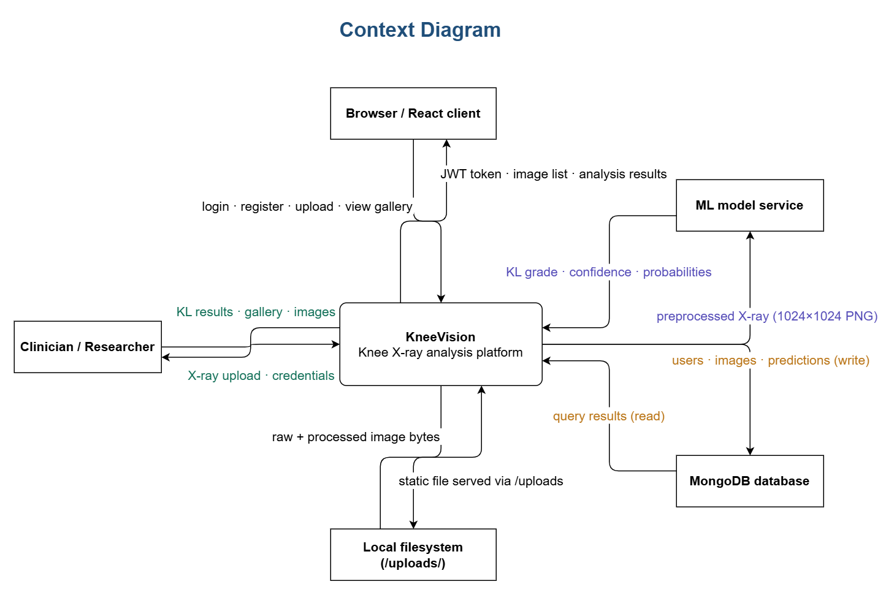
Context Diagram

Slide 22
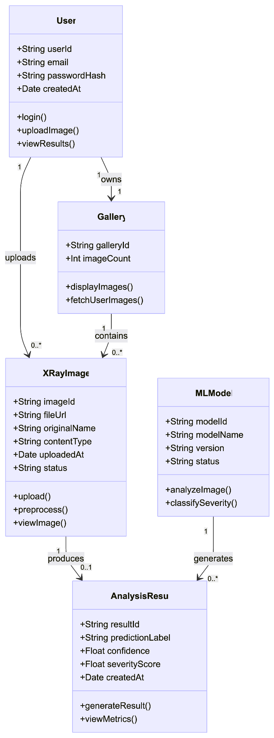
Class Diagram

Slide 23
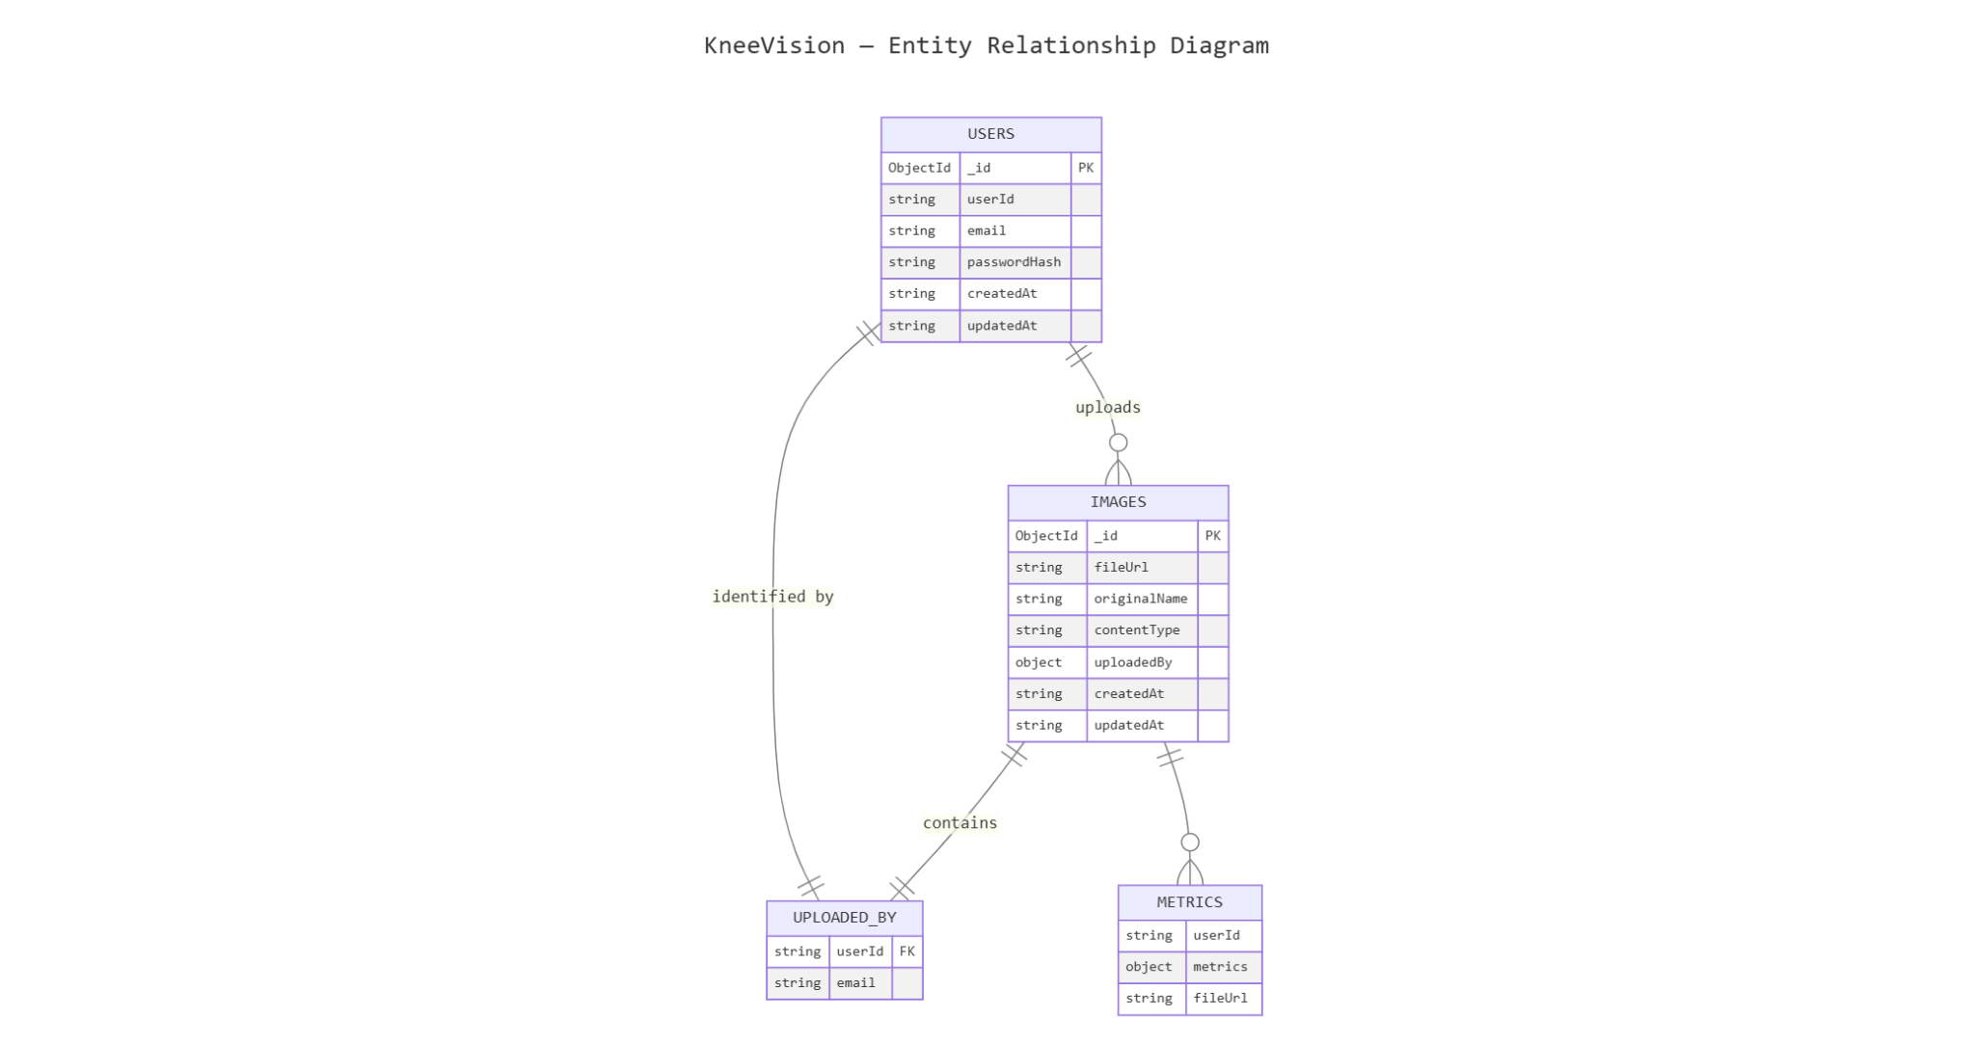
ER Diagram

Slide 24
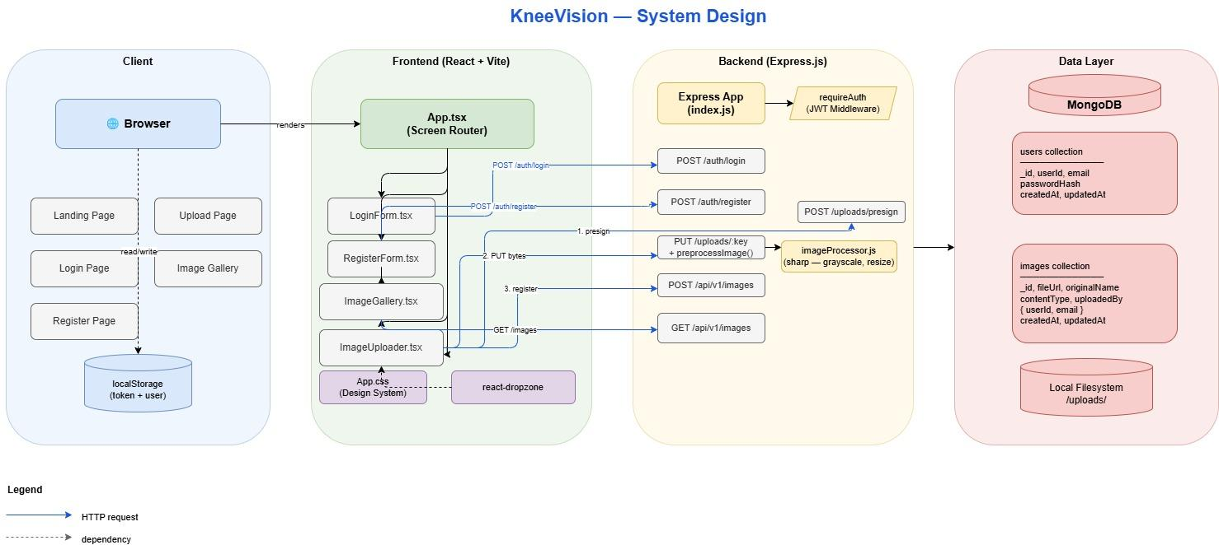
Architecture Diagram

Slide 25
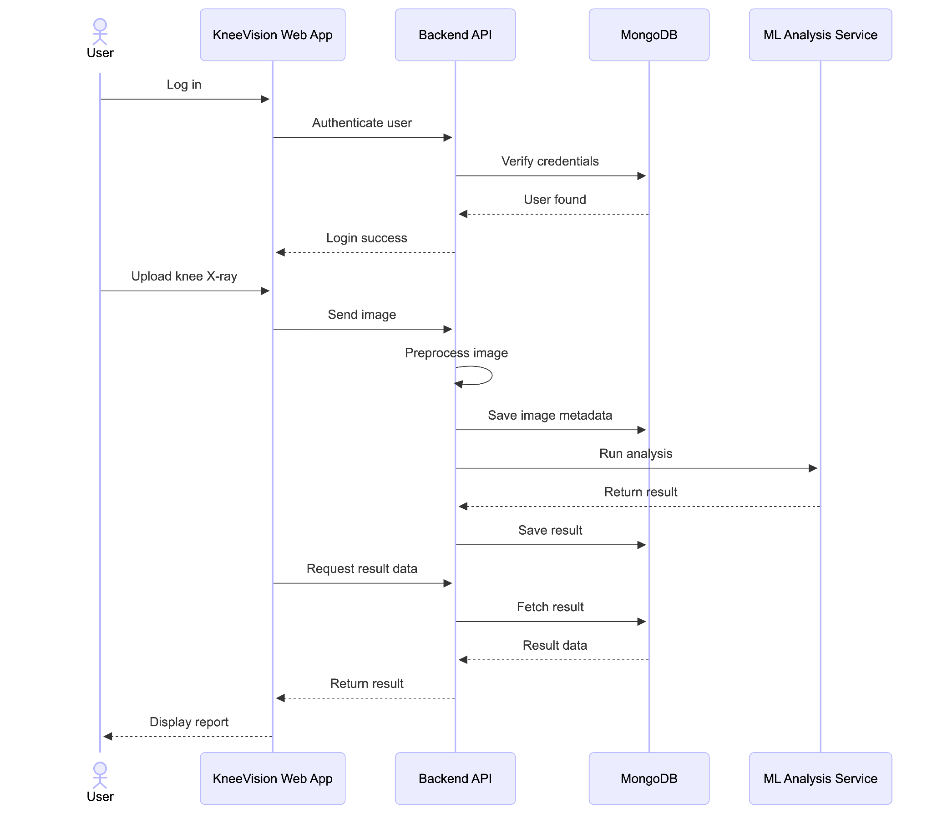
Sequence Diagram

Slide 26
State Diagram

Slide 27
PROJECT BACKLOG - USER STORIES
US_ID
User Stories
Acceptance Criteria
Feature
Story Points
US_01
As an individual user, I want to upload knee X-ray images so that I can receive an AI-based assessment of osteoarthritis severity.
The patient can access an interface to upload an image.
The patient can select and submit an image from device.
The system accepts image files in specified formats: JPEG, JPG, PNG, DICOM.
The uploaded image is stored and associated with the patient's case.
A confirmation message is displayed upon successful upload.
Image Upload
13
US_02
As a research coordinator, I want to upload multiple X-ray images at once so that I can analyze datasets efficiently.
The patient can upload multiple images (up to 3) to one case.
The system accepts multiple images in specified formats (JPEG, JPG, PNG).
All uploaded images are associated with the same patient case.
The patient receives a confirmation message after uploading each image.
The system displays a preview of all uploaded images for review before analysis.
Image Upload
8

Slide 28
PROJECT BACKLOG - USER STORIES
US_ID
User Stories
Acceptance Criteria
Feature
Story Points
US_03
As an individual user, I want to register an account so that I can store my basic information and access personalised services.
The user can access a registration page requiring: Full name, Email address, Password creation.
Post-registration, the user can log in and update their profile information.
User Management
2
US_04
As an individual user, I want to log in to my account so that I can manage my cases and view diagnoses.
The user accesses a login page requiring: Email address, Password.
Upon successful login, the user is directed to their dashboard.
User Management
1
US_05
As a user, I want to view my past cases and track their statuses so that I can monitor my health progress.
The user can access a 'Case History' section after logging in.
All past cases are listed in chronological order (most recent first).
Each case displays: case ID, case open date, status.
The system updates case statuses in real-time.
Clicking on a case entry navigates the user to that case's report.
User Management
2
US_06
As an individual user, I want to implement JWT authentication so that my session is secure.
JWT tokens are generated on login and validated on every protected route.
Tokens expire after a defined period and require re-authentication.
Invalid or expired tokens return a 401 Unauthorized response.
User Management
3

Slide 29
PROJECT BACKLOG - USER STORIES
US_ID
User Stories
Acceptance Criteria
Feature
Story Points
US_07
As an individual user, I want to receive an OA severity diagnosis so that I know the knee condition I am facing.
After submitting the image, the user receives a diagnosis.
The diagnosis is presented as the KL grade (0–4) and severity label.
The system provides the diagnosis within a reasonable time (< 1 min).
The diagnosis is stored and associated with the user's case.
AI Model Integration
20
US_08
As an individual user, I want to receive the most accurate possible diagnosis so that I can trust the assessment provided.
The system continuously improves the model and algorithms for better diagnostic results.
The diagnosis accuracy is optimised based on model refinements and external validation.
The confidence level of the diagnosis should be high (e.g., 95%).
AI Model Integration
11
US_09
As an individual user, I want to receive a brief description of the diagnosed condition so that I can understand the issue I am facing.
After receiving the diagnosis, the user is provided with a brief description of the diagnosed condition.
The description is written in clear, understandable language.
The description includes common symptoms and causes.
AI Model Integration
2
US_10
As an individual user, I want to receive treatment recommendations so that I can take action towards treating my knee condition.
After receiving the diagnosis, the user is provided with treatment recommendations.
The description is written in clear, understandable language.
The description includes common symptoms and causes of the condition.
AI Model Integration
3

Slide 30
Sprint 1 - USER STORIES
US_ID
User Stories
Acceptance Criteria
Feature
US_01
As an individual user, I want to upload knee X-ray images so that I can receive an AI-based assessment of osteoarthritis severity.
The patient can access an interface to upload an image.
The patient can select and submit an image from device.
The system accepts image files in specified formats: JPEG, JPG, PNG, DICOM.
The uploaded image is stored and associated with the patient's case.
A confirmation message is displayed upon successful upload.
Image Upload
US_07
As an individual user, I want to receive an OA severity diagnosis so that I know the knee condition I am facing.
After submitting the image, the user receives a diagnosis.
The diagnosis is presented as the KL grade (0–4) and severity label.
The system provides the diagnosis within a reasonable time (< 1 min).
The diagnosis is stored and associated with the user's case.
AI Model Integration

Slide 31
SPRINT 1 STORIES COMPLETED AND NOT
US_ID
User Stories
Completed Date
Story Points
Completed
US_01
As an individual user, I want to upload knee X-ray images so that I can receive an AI-based assessment.
31
31
Scrum 24
Create login page UI
Feb 18
3
3
Scrum 23
Create registration page UI
Feb 18
2
2
Scrum 17
Create database schema (users, images tables)
Mar 13
5
5
Scrum 18
Build user registration API endpoint
Mar 13
3
3
Scrum 19
Build user login API with JWT
Mar 18
3
3
Scrum 20
Build image upload API endpoint
Mar 13
3
3
Scrum 21
Implement image preprocessing (resize, normalize)
Mar 3
2
2
Scrum 25
Build drag-and-drop image upload component
Mar 17
3
3
Scrum 26
Create image gallery view with thumbnails
Mar 17
2
2
Scrum 27
Implement JWT authentication flow
Mar 18
3
3
Scrum 28
Add form validation and error handling
Mar 18
2
2
US_07
As an individual user, I want to receive an OA severity diagnosis.
21
21
Scrum 35
Download OAI dataset (500+ images)
Mar 17
3
3
Scrum 36
Prepare and clean dataset
Mar 18
3
3

Slide 32
SPRINT 1 STORIES COMPLETED AND NOT
US_ID
User Stories
Completed Date
Story Points
Completed
Scrum 32
Integration testing (frontend + backend)
Mar 18
3
3
Scrum 31
Test image upload (JPEG, PNG, DICOM)
Mar 18
2
2
Scrum 30
Test registration and login flows
Mar 13
3
3
Scrum 29
Write test cases (15+ total)
Mar 13
3
3
Scrum 22
Write backend unit tests
Mar 18
2
2
Scrum 51
Start technical paper - Introduction
Mar 18
2
2
Sprint 1 Story Points: 52

Slide 33
SPRINT 0 PRE-PLANNING
SCRUM ID
Task
Assignee
Updated
Points
SCRUM-1
Define problem statement and project description
Daniel Fox
Feb 18
5
SCRUM-2
Create 3 user personas (Dr. Chen, Alex, Maya)
Manohar
Feb 18
3
SCRUM-3
Finalize technologies and algorithms
Deep
Feb 18
1
SCRUM-4
Finalize MVP overview
Daniel Fox
Feb 18
2
SCRUM-5
Finalize Team Working Agreement
Manohar
Feb 18
1
SCRUM-6
Finalize Team roles and responsibilities
Swatej Goud Mella
Feb 18
2
SCRUM-7
Finalize Project Schedule
Manohar
Feb 18
2
SCRUM-8
Sprint 0 Retrospective and recording
Daniel Fox
Feb 18
1
SCRUM-9
Finalize Sprint 0 Presentation
Deep
Feb 18
3
SCRUM-10
Sprint 0 Presentation and recording
Daniel Fox
Feb 19
2
SCRUM-11
Research knee OA datasets (OAI, MOST)
Sarvesh Shah
Feb 18
5
SCRUM-12
Create Jira Project and invite all teammates
Daniel Fox
Feb 18
2
SCRUM-13
Complete GitHub wiki page
Siming Li
Feb 19
1
SCRUM-14
Create Sprint 1 backlog, planning, and recording
Daniel Fox
Feb 19
2
SCRUM-16
Submit Sprint 0 deliverables and update wiki page
Daniel Fox
Feb 19
2

Slide 34
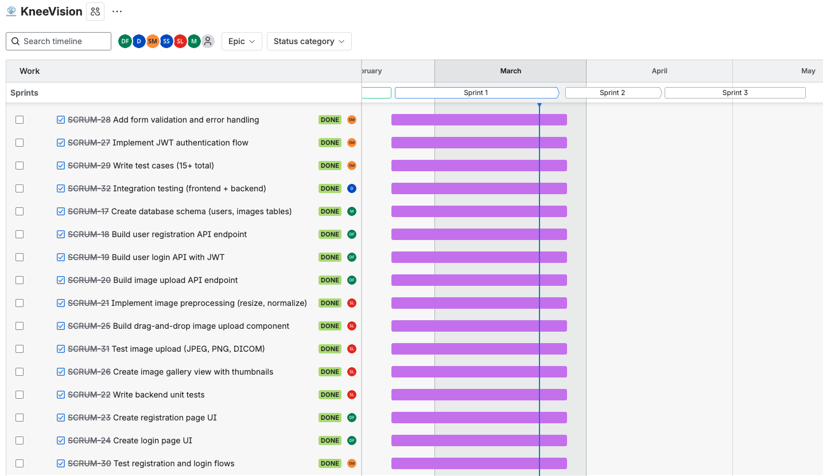
Project Schedule - Sprint 1
Notes:
SL start

Slide 35
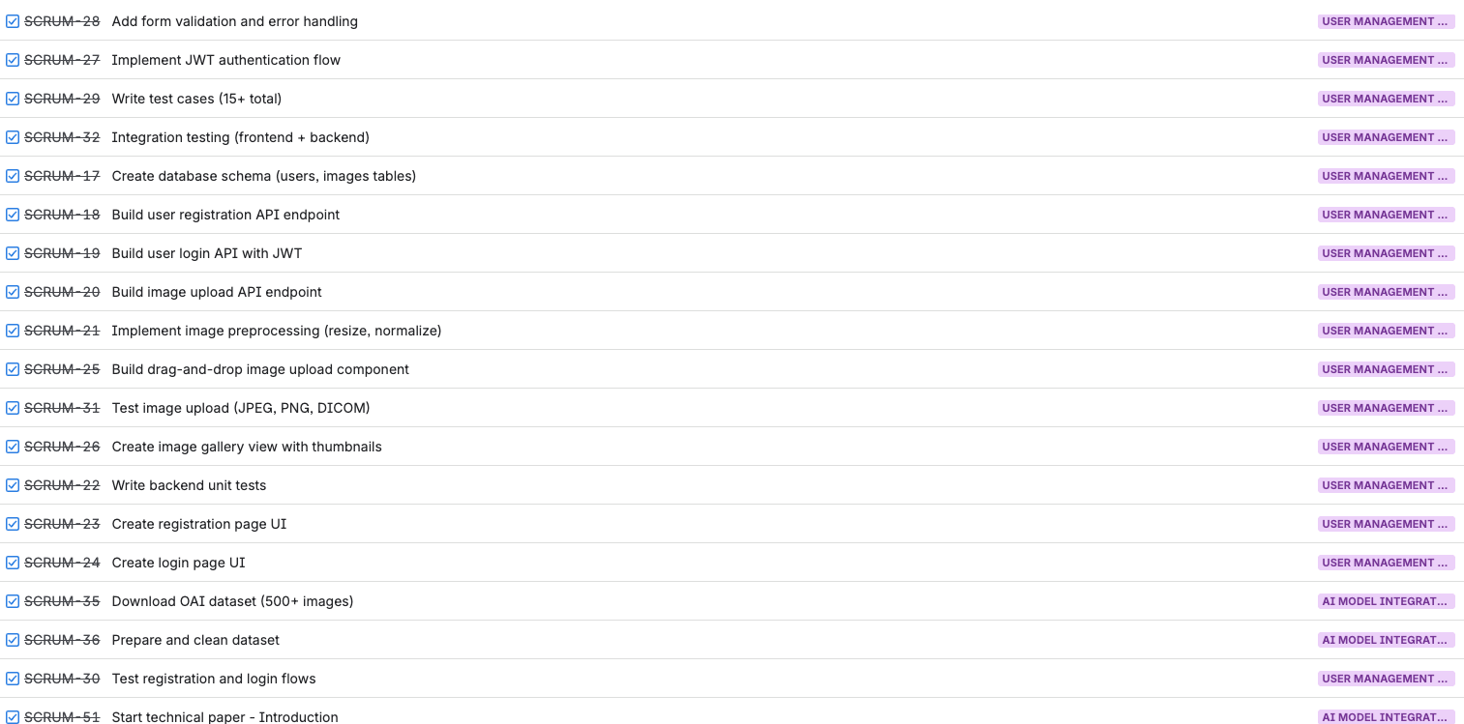
Product Backlog - Completed in Sprint 1

Slide 36
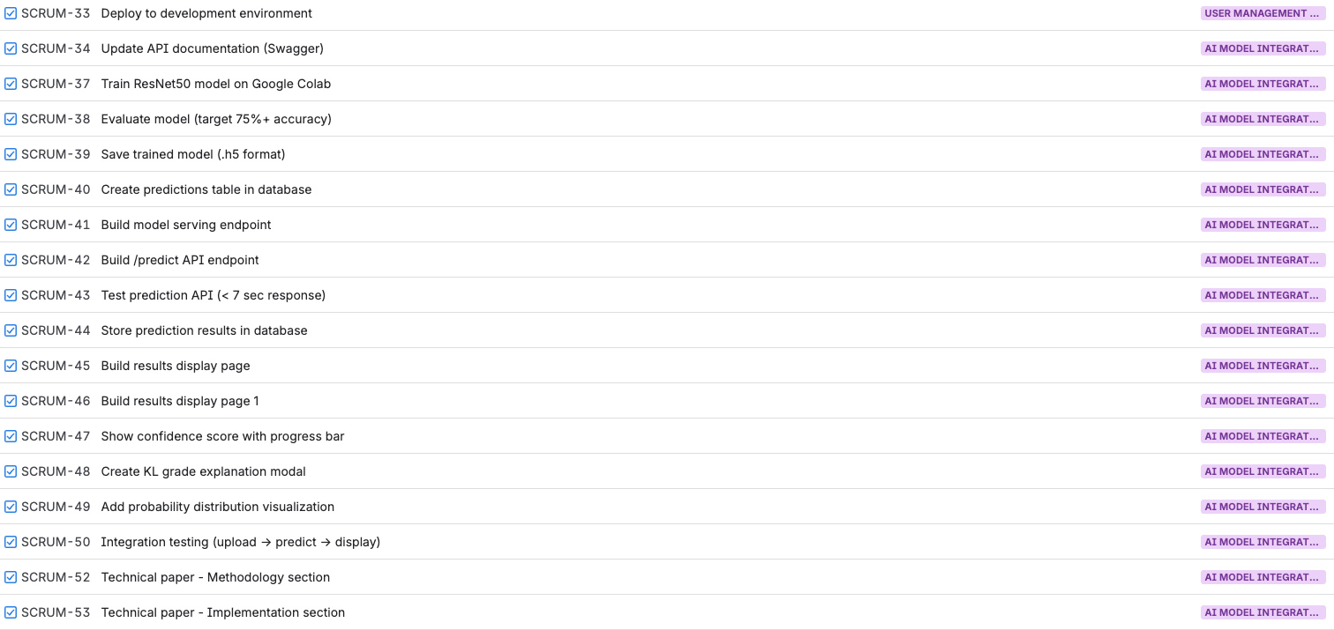
Product Backlog - Outstanding

Slide 37
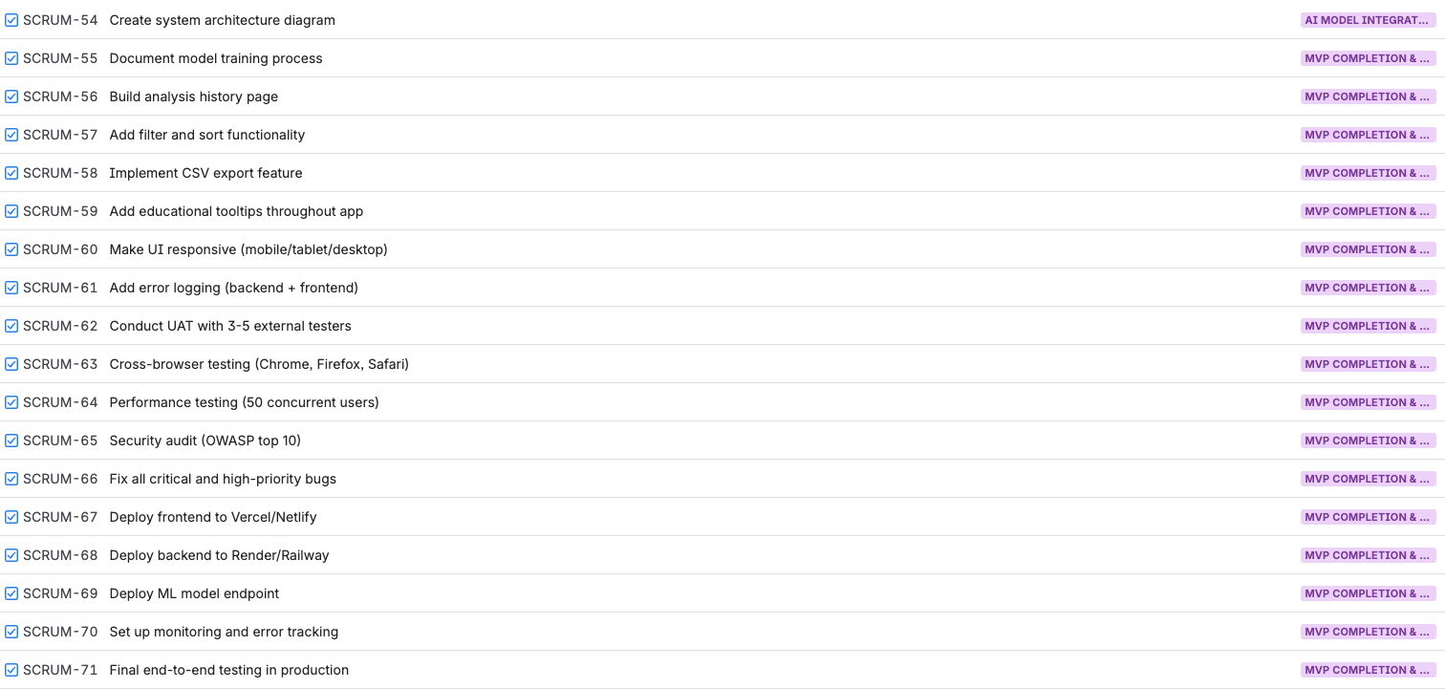
Product Backlog - Outstanding

Slide 38
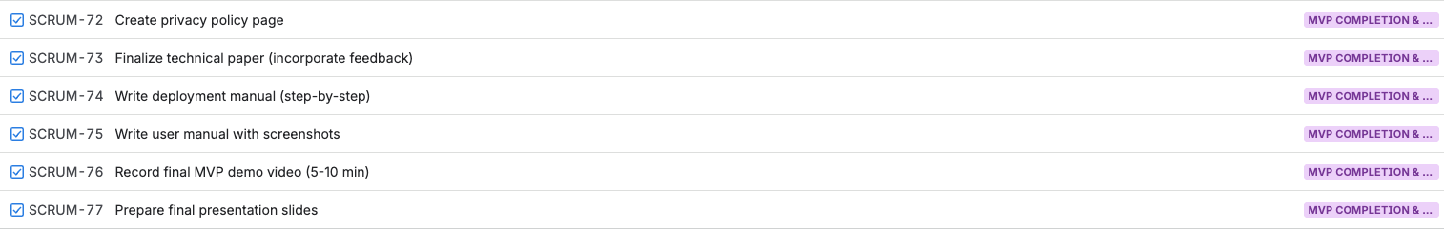
Product Backlog - Outstanding
Notes:
SL ends

Slide 39
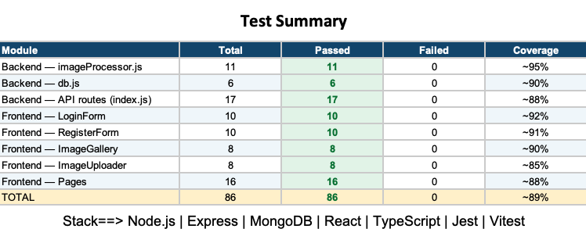
Test Cases

Slide 40
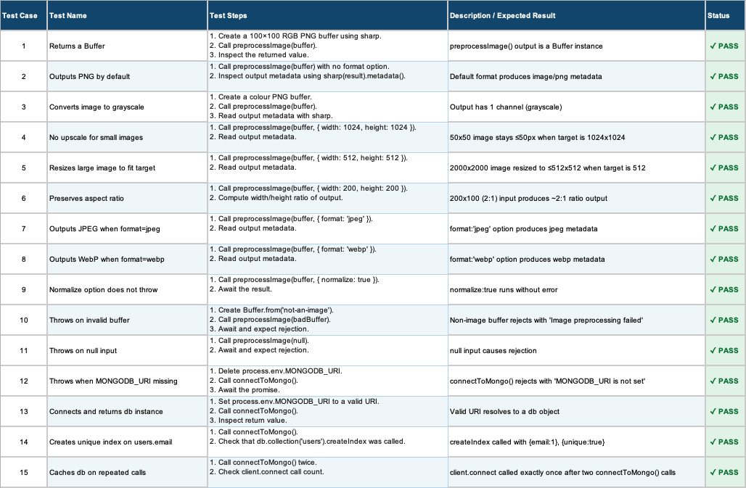
Test Cases - Backend

Slide 41
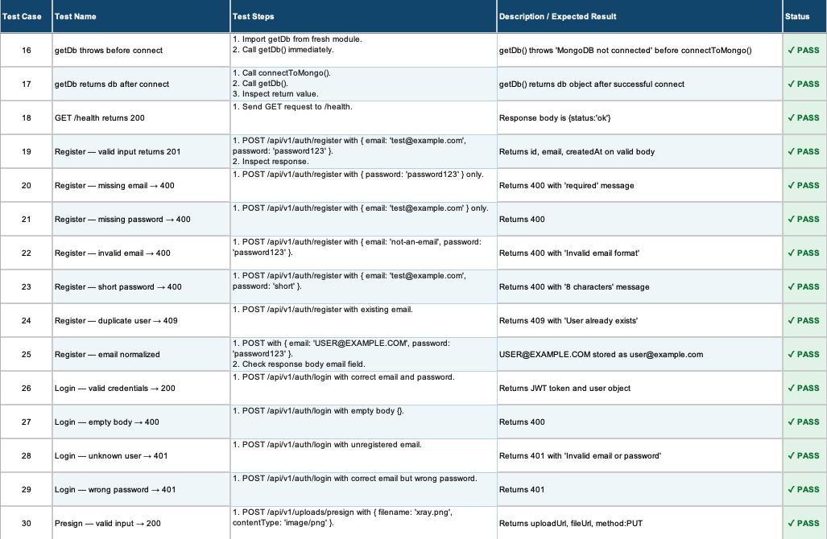
Test Cases - Backend

Slide 42
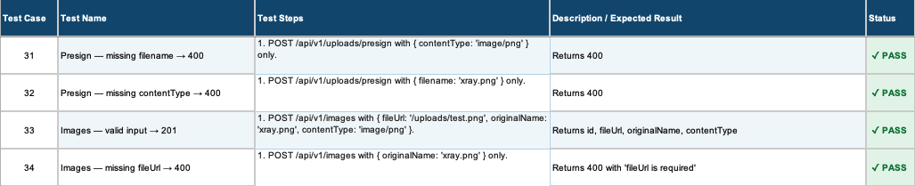
Test Cases - Backend

Slide 43
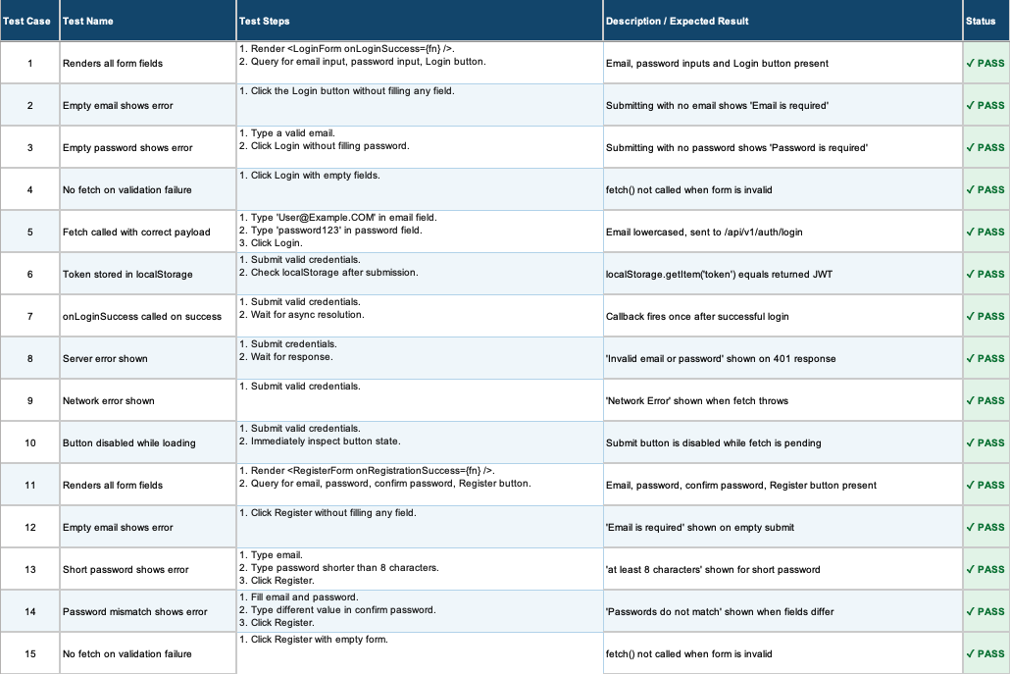
Test Cases - Frontend

Slide 44
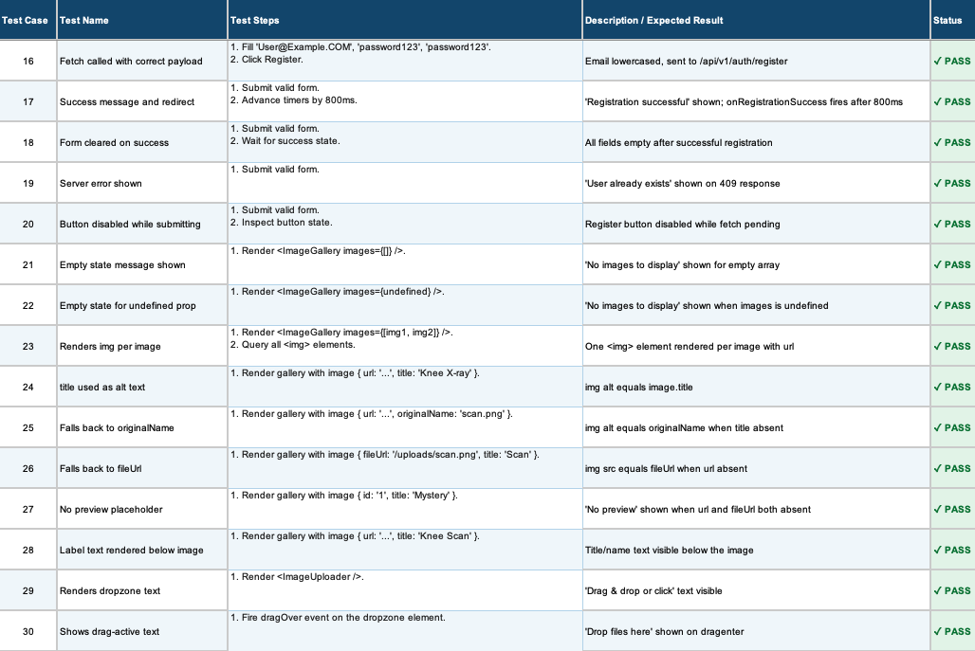
Test Cases - Frontend

Slide 45
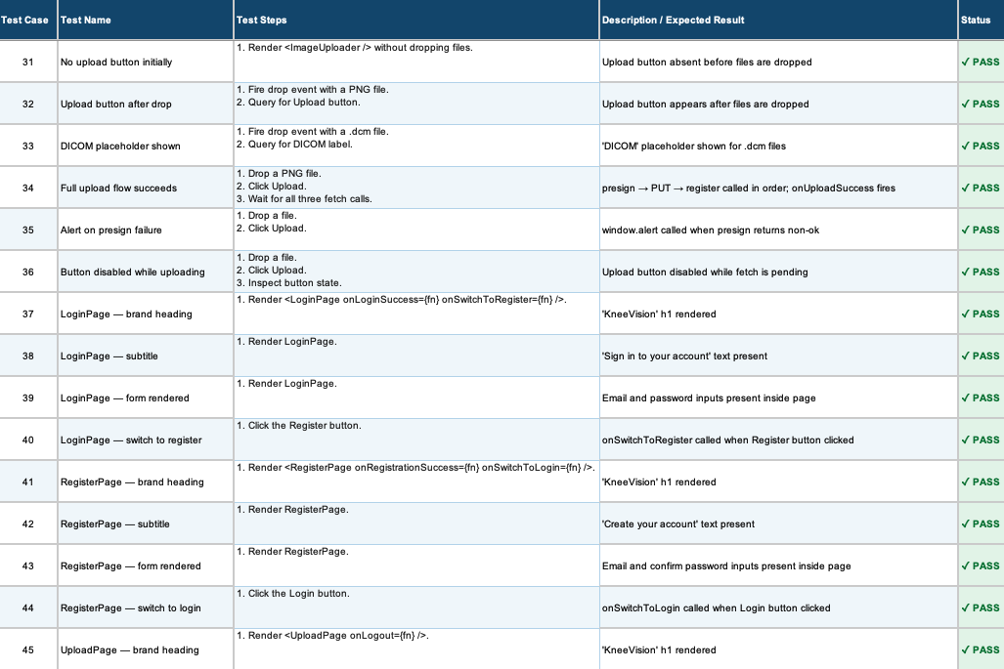
Test Cases - Frontend

Slide 46
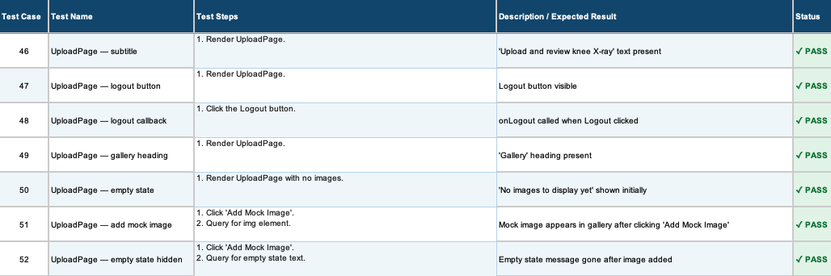
Test Cases - Frontend

Slide 47
Metrics - Team Velocity
52 story points completed

Slide 48
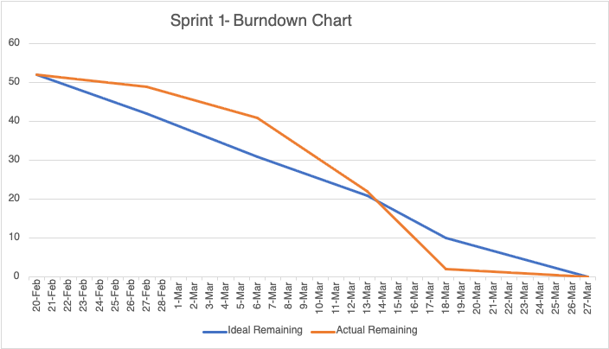
Metrics - Burndown Chart

Slide 49
Metrics - Completed/Committed Ratio
52 / 52
100%
Sprint 1 Story Points: 52

Slide 50
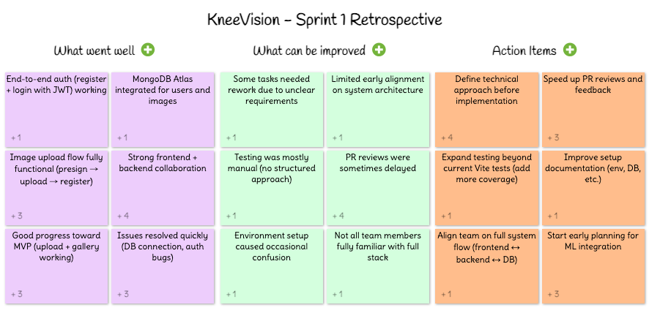
Sprint 1 Retrospective

Slide 51

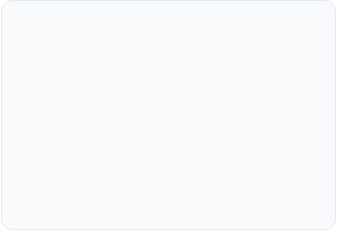
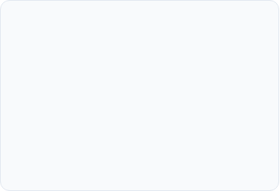



Sprint 1 Retrospective: Important Points
What Went Well
Improvements
Action Items
Strong frontend + backend collaboration
Image upload flow fully functional
Good progress toward MVP
Issues resolved quickly
PR reviews were sometimes delayed
Define technical approach before implementation
Start early planning for ML integration

Slide 52



Project Roadmap
Sprint Schedule & Key Deliverable
0
1
2
3
DEADLINE: FEB 19
DEADLINE: MAR 26
DEADLINE: APR 16
DEADLINE: MAY 14
Foundation
Core Features
AI Engine
Deployment
Project Charter & MVP
User Auth
Model Training
History & CSV Export
GitHub & Tech Stack Setup
Image Upload
Prediction API
Security & UAT Audit
Backlog Creation
Image Gallery
KL Grade Results
Production Launch
DELIVERABLES:
DELIVERABLES:
DELIVERABLES:
DELIVERABLES:
Presentation + Wiki + Backlog
Working Demo + Wiki + Tests
AI Demo + Draft Paper + Wiki
Final MVP + Full Documentation

Slide 53
SPRINT 2 - USER STORIES
US_ID
User Stories
Acceptance Criteria
Feature
Story Points
US_09
As an individual user, I want to receive a brief description of the diagnosed condition so that I can understand the issue I am facing.
After receiving the diagnosis, the user is provided with a brief description of the diagnosed condition.
The description is written in clear, understandable language.
The description includes common symptoms and causes.
AI Model Integration
2
US_02
As a research coordinator, I want to upload multiple X-ray images at once so that I can analyze datasets efficiently.
The patient can upload multiple images (up to 3) to one case.
The system accepts multiple images in specified formats (JPEG, JPG, PNG).
All uploaded images are associated with the same patient case.
The patient receives a confirmation message after uploading each image.
The system displays a preview of all uploaded images for review before analysis.
Image Upload
8
US_08
As an individual user, I want to receive the most accurate possible diagnosis so that I can trust the assessment provided.
The system continuously improves the model and algorithms for better diagnostic results.
The diagnosis accuracy is optimised based on model refinements and external validation.
The confidence level of the diagnosis should be high (e.g., 95%).
AI Model Integration
11
US_10
As an individual user, I want to receive treatment recommendations so that I can take action towards treating my knee condition.
After receiving the diagnosis, the user is provided with treatment recommendations.
The description is written in clear, understandable language.
The description includes common symptoms and causes of the condition.
AI Model Integration
3

Slide 54
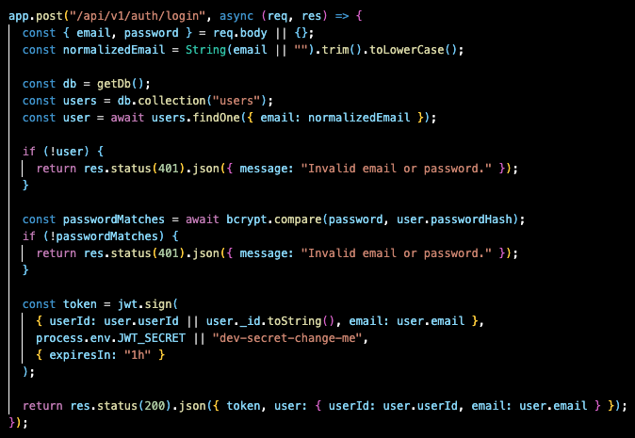
Project - APIs - Login API

Slide 55
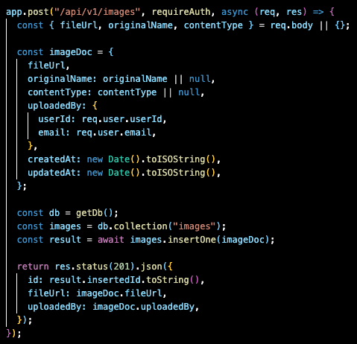
Project - APIs - Upload Image API

Slide 56
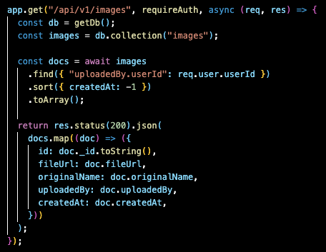
Project - APIs - Get Images API

Slide 57
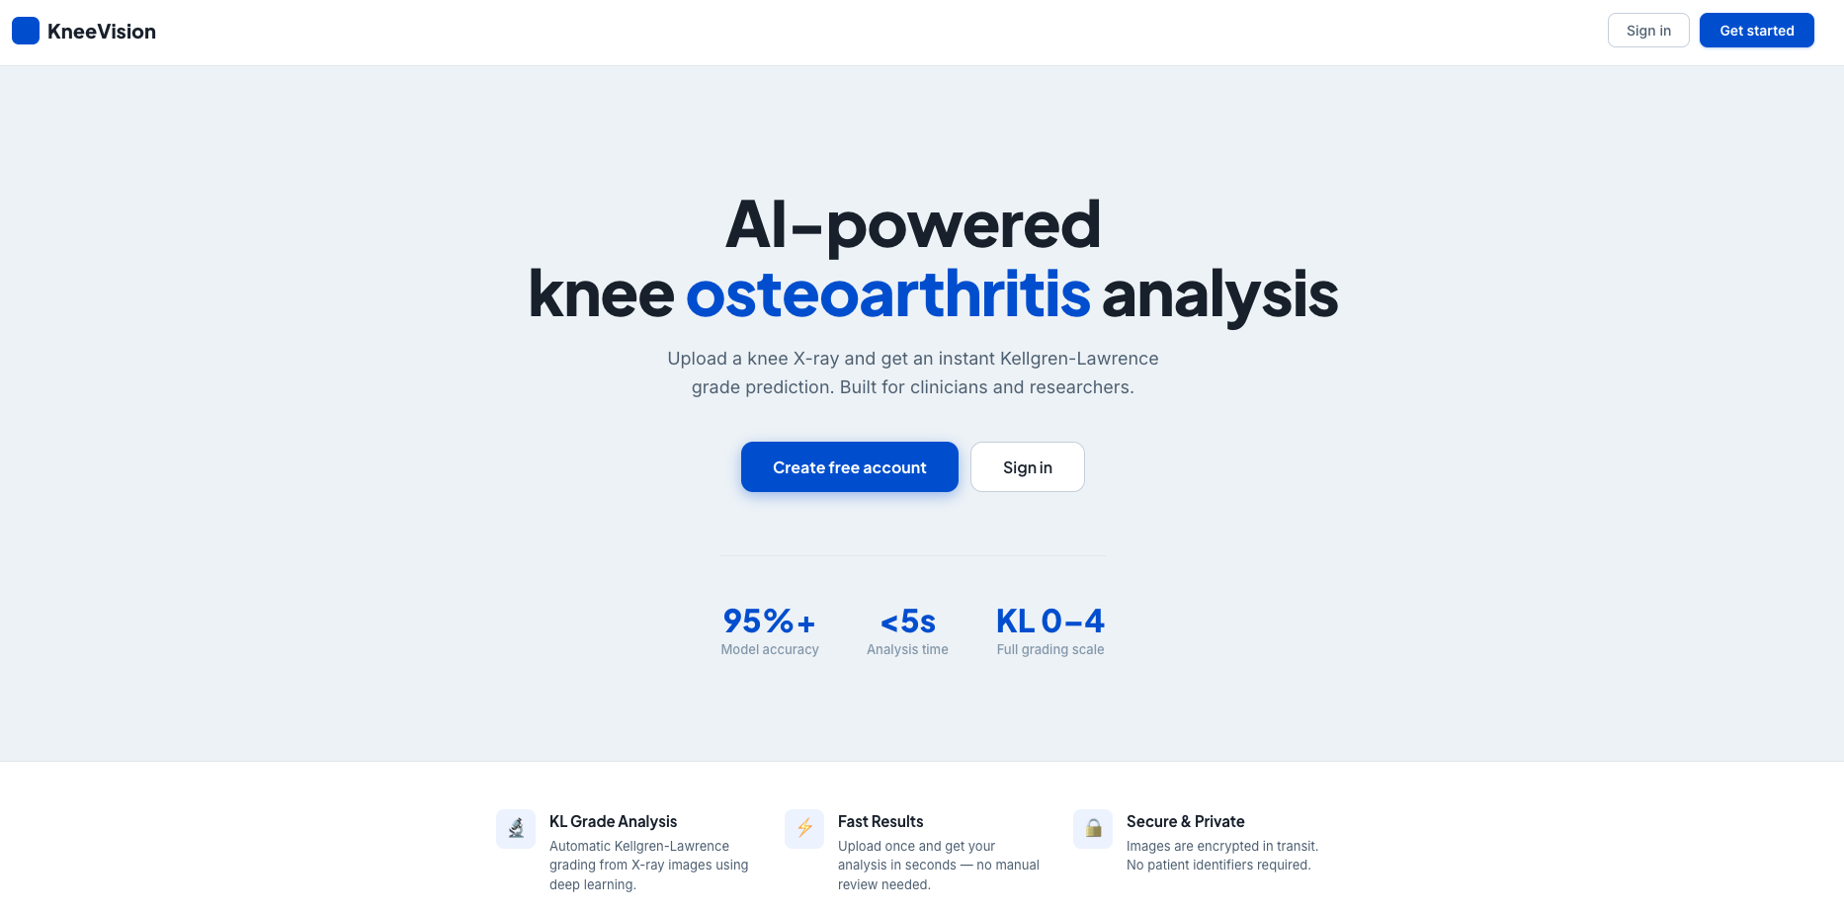
Project Demo - Application Screenshots

Slide 58
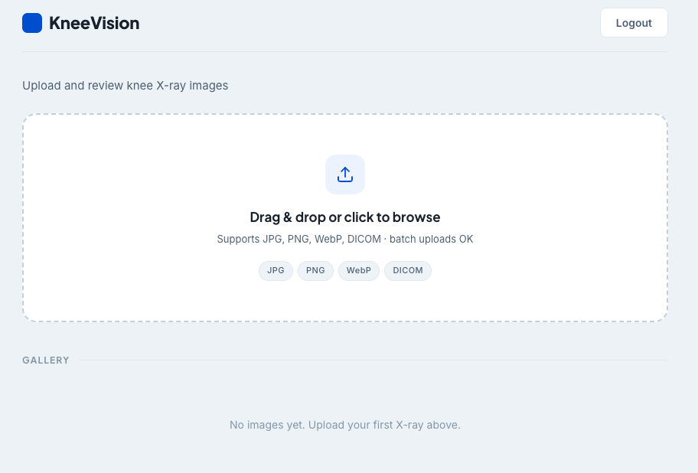
Project Demo - Application Screenshots

Slide 59
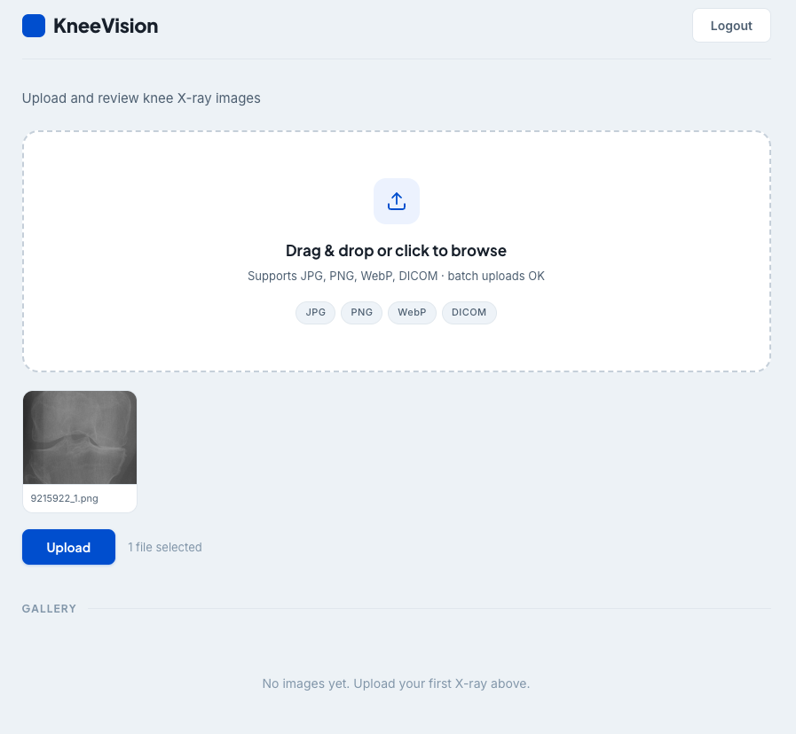
Project Demo - Application Screenshots

Slide 60
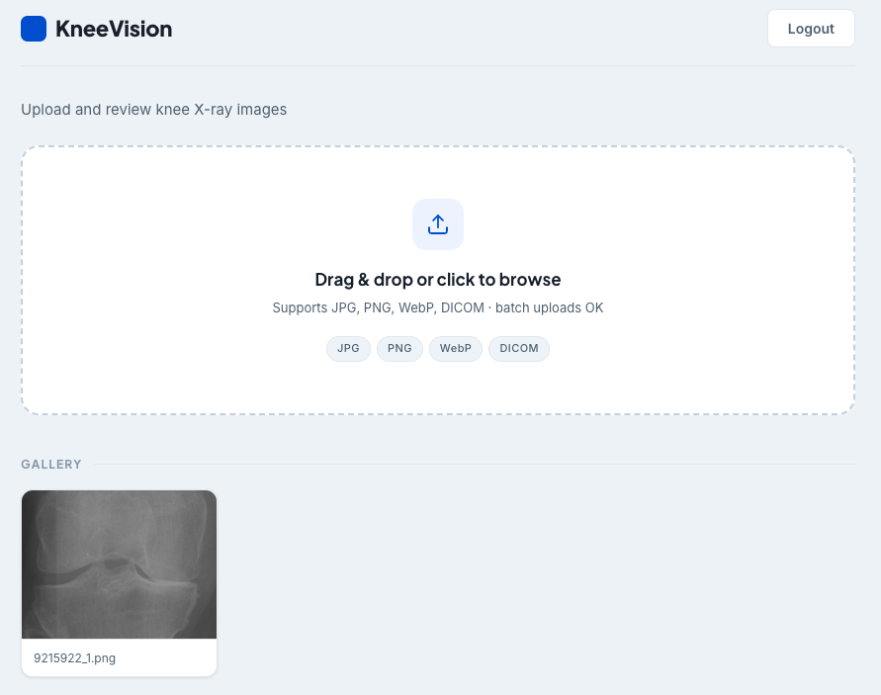
Project Demo - Application Screenshots

Slide 61
Wiki Page Link
https://github.com/htmw/STARLABS/wiki#kneevision

Slide 62
Live Application Demo

Slide 63
AI Disclosure
Assisted in generating initial user stories and backlog items
Helped draft test cases and testing scenarios
Supported development of specific backend API routes (authentication, image upload, and database integration) and frontend components (forms, state handling, and API calls)
Provided guidance for debugging and resolving errors
Assisted with structuring documentation and project artifacts

Slide 64
THANK YOU
Team S.T.A.R Labs

